Slide 1

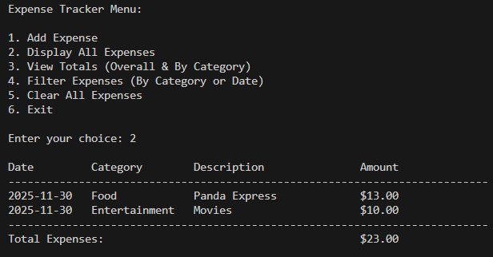
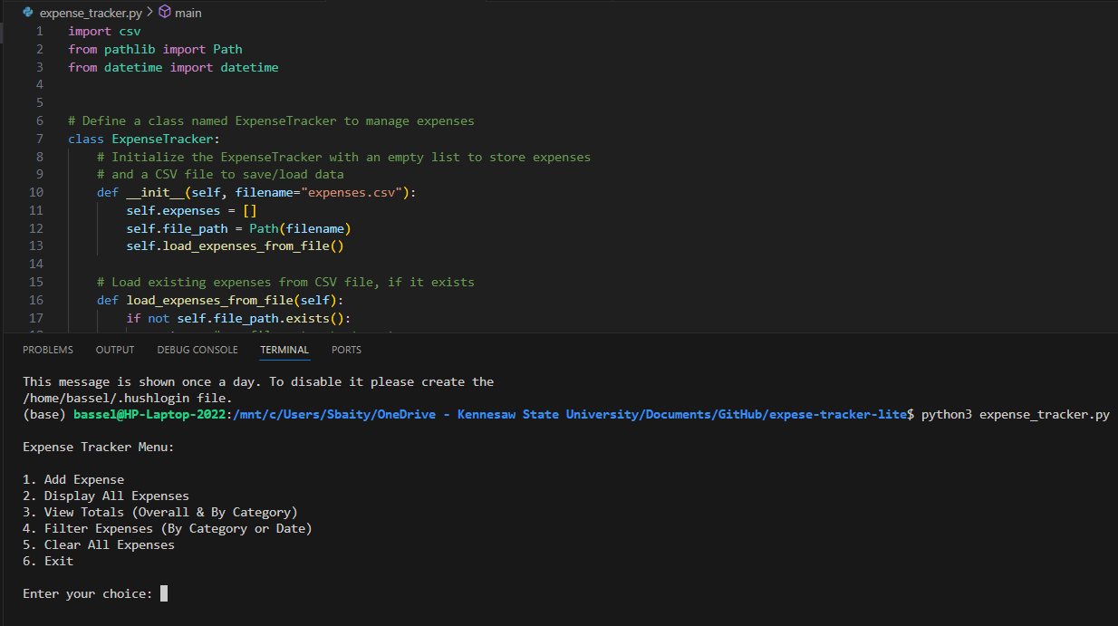
Expense Tracker Lite
Simple daily spending tracker with CSV storage and smart filters
Project Member(s): Bassel Sbaity
GitHub Repo URL: https://github.com/ksu-is/expese-tracker-lite
Allows users to add expenses with date, category, description, and amount
Saves and loads all expenses from expenses.csv
Shows total spending and totals by category
Filters expenses by date or category
Basic input validation to avoid bad data

